Slide 1
Entity Framework
http://www.entityframeworktutorial.net

Slide 2
Topics
What is Entity Framework?
Basic Workflow in Entity Framework
How Entity Framework Works?
Entity States in Entity Framework
Development Approaches with Entity Framework

Slide 3
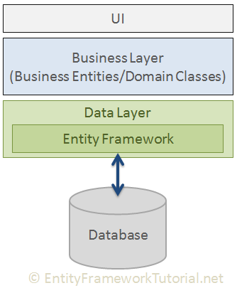
What is Entity Framework?
Entity Framework is an open-source ORM framework for .NET applications supported by Microsoft.
Object Relational Mapping (ORM) is a technique of accessing a relational database from an object-oriented language.

Slide 4
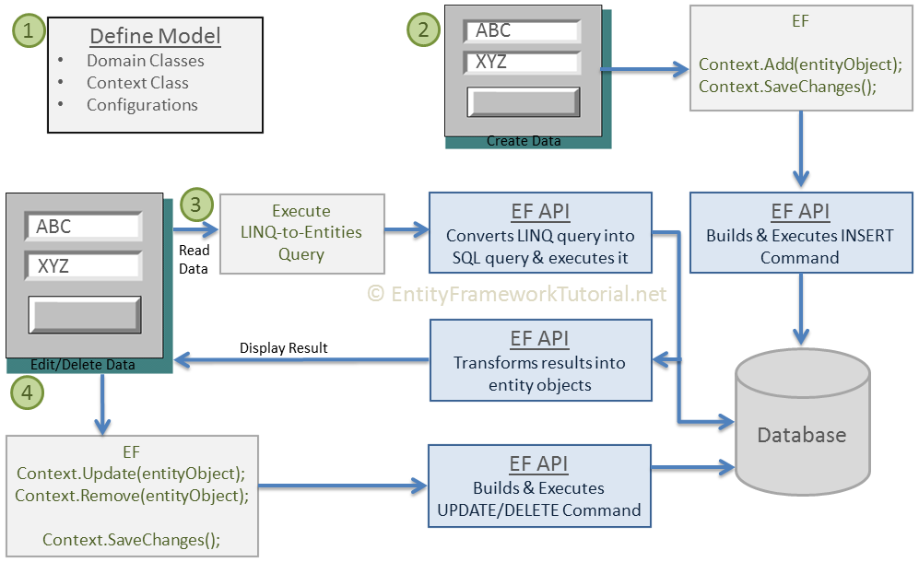
Basic Workflow in Entity Framework

Slide 5
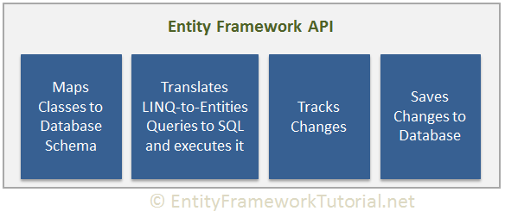
How Entity Framework Works?

Slide 6
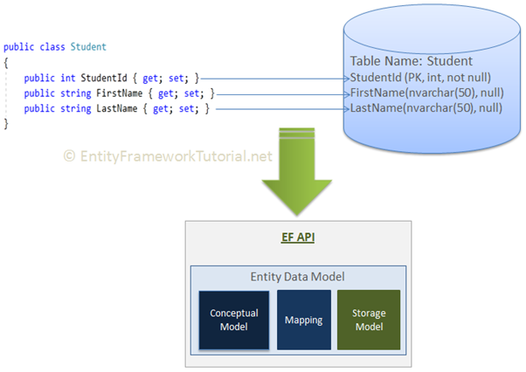
How Entity Framework Works?

Slide 7
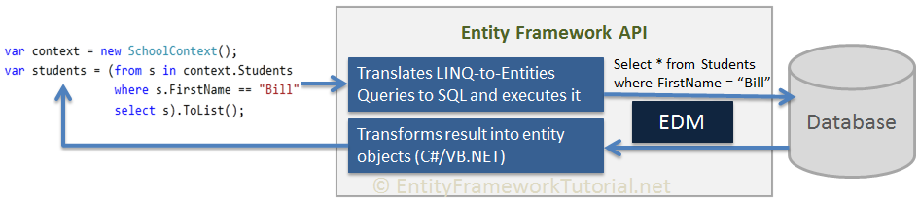
How Entity Framework Works?

Slide 8
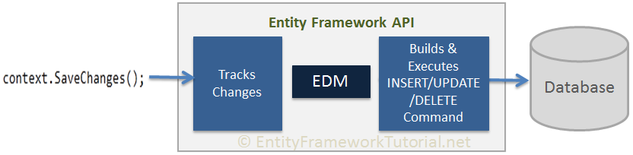
How Entity Framework Works?

Slide 9
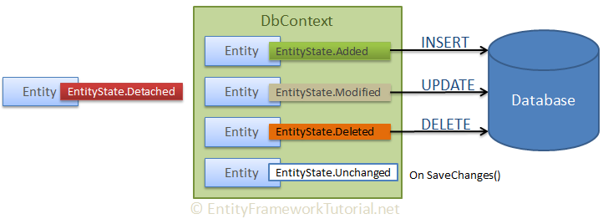
Entity States in Entity Framework
Added
Modified
Deleted
Unchanged
Detached

Slide 10
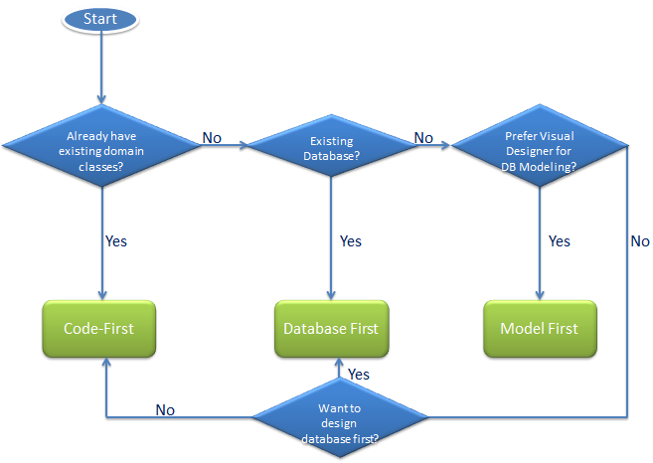
Development Approaches with Entity Framework
Database-First
Code-First
Model-First

Slide 11
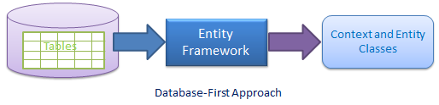
Development Approaches WITH Database-First

Slide 12
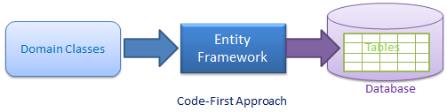
Development Approaches with Code-First

Slide 13
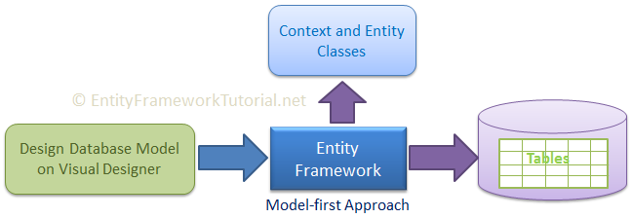
Development Approaches with Model-First

